Slide 1
Fredericton High School Grade 8 Parent Orientation

Slide 2
FHS Administration
Ms. Stephanie Tomilson, Principal
- Ms. Amy Bourgaize, Vice Principal (A-Co)
- Mrs. Amy Thompson , Vice Principal (Cr-Hi)
- Mr. Fred Connors, Vice Principal (Ho-Mc)
- Mrs. Laurie Pearson, Vice Principal (Me-Sc)
- Mr. Peter Batt, Vice Principal (Se-Z)

Slide 3
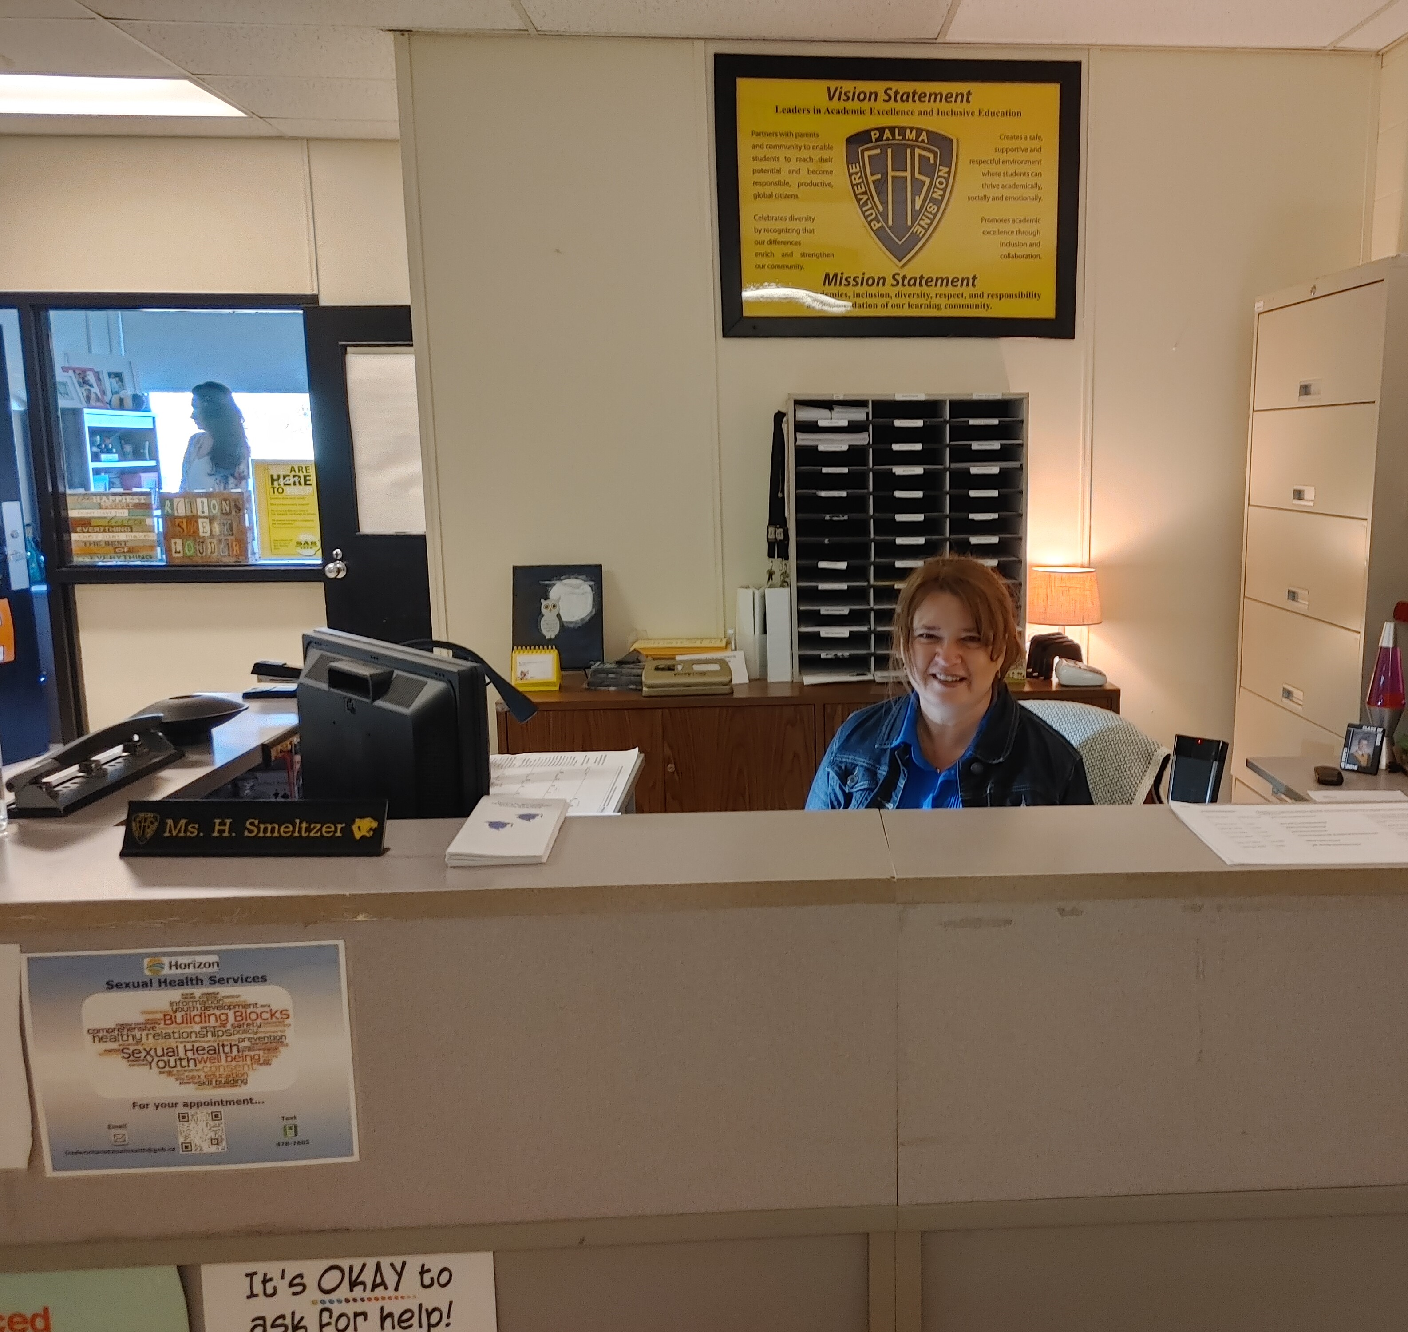
Guidance Department
Mr. Peter Cook (A-Co)
Mrs. Cristel Hamilton (Cr-Hi)
Mr. Adam Dionne (Ho-Mc)
Mrs. Suzanne Maxwell (Me-Sc)
Mrs. Diane Langille (Se-Z)
Admin Assistant –
Harmony Smeltzer
Come to Guidance to make an appointment!

Slide 4
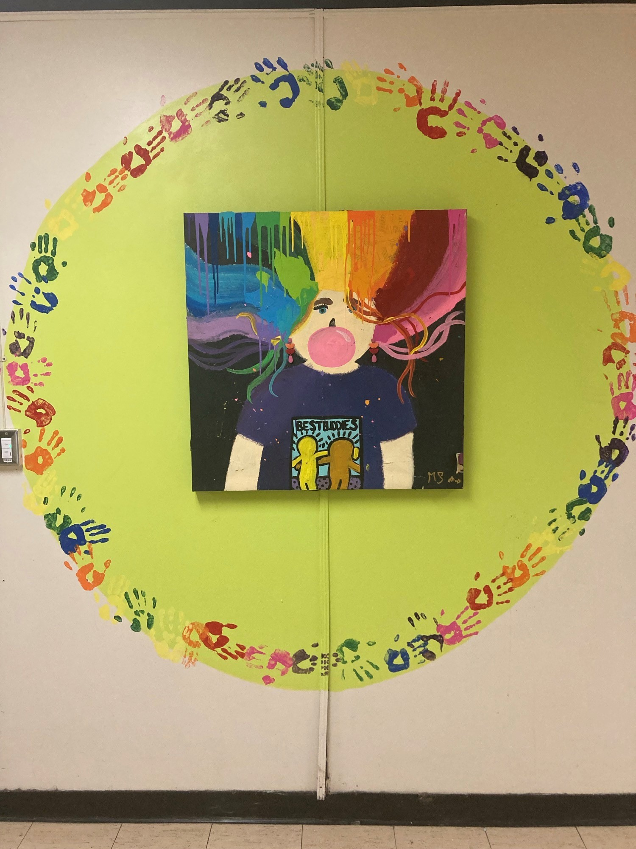
Resource Support
SPR’s of Resource
Marla McCarthy
Jenna Esligar
*Letters will be assigned to EST-R teachers once staffing is finalized

Slide 5
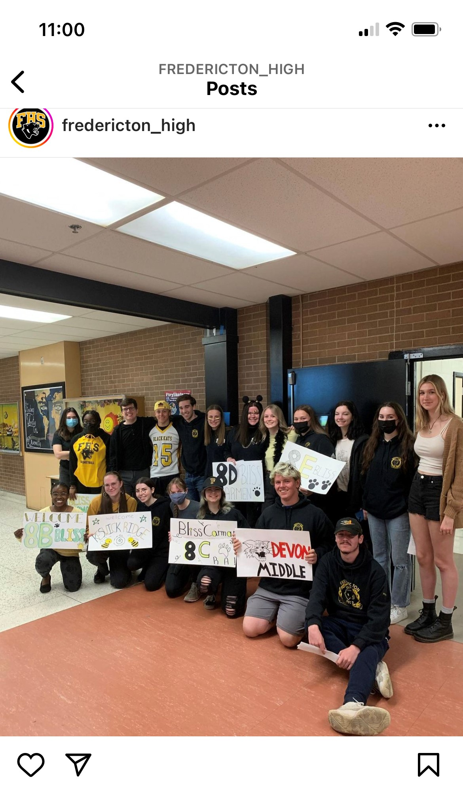
Video created by Daily Roar Students to welcome grade 8s to the school.
https://www.youtube.com/watch?v=Grade 8 Welcome Tour

Slide 6
Grade 9 Courses
Semester Courses (Sept – Jan & Feb – June)
English Literary Texts 9
English Informational Texts 9
Math 9A*
Math 9B*
Science 9*
Social Studies 9*
French (PIF9 or FILA 9*)
Broad Based Technology 9 (BBT)
Health and Phys. Ed. 9
Half Semester Courses (45 hours each)
Music 9
Visual Arts 9
*FI students take these in French

Slide 7
FHS Schedule for 2022-2023
MORNING
Homeroom (8:30)
Period 1
Period 2
Period 3
Lunch (12:15-1:15)
AFTERNOON
Period 4
Period 5
Dismissal (3:25)

Slide 8
SAMPLE Student Schedule
Student Name: ____________
Semester 2

Slide 9
Tips for Parents
Encourage your child to GET INVOLVED!
Clubs – Chess, Games, Debating, Glee Choir, Kats Kitchen, Best Buddies, Safe Space, etc.…
Intramurals – floor hockey, basketball, badminton, etc.…
Sports – Soccer, Baseball, Track and Field, Football, Rugby, etc.….
Academic support – Peer tutoring, Math Help Center, etc.

Slide 10
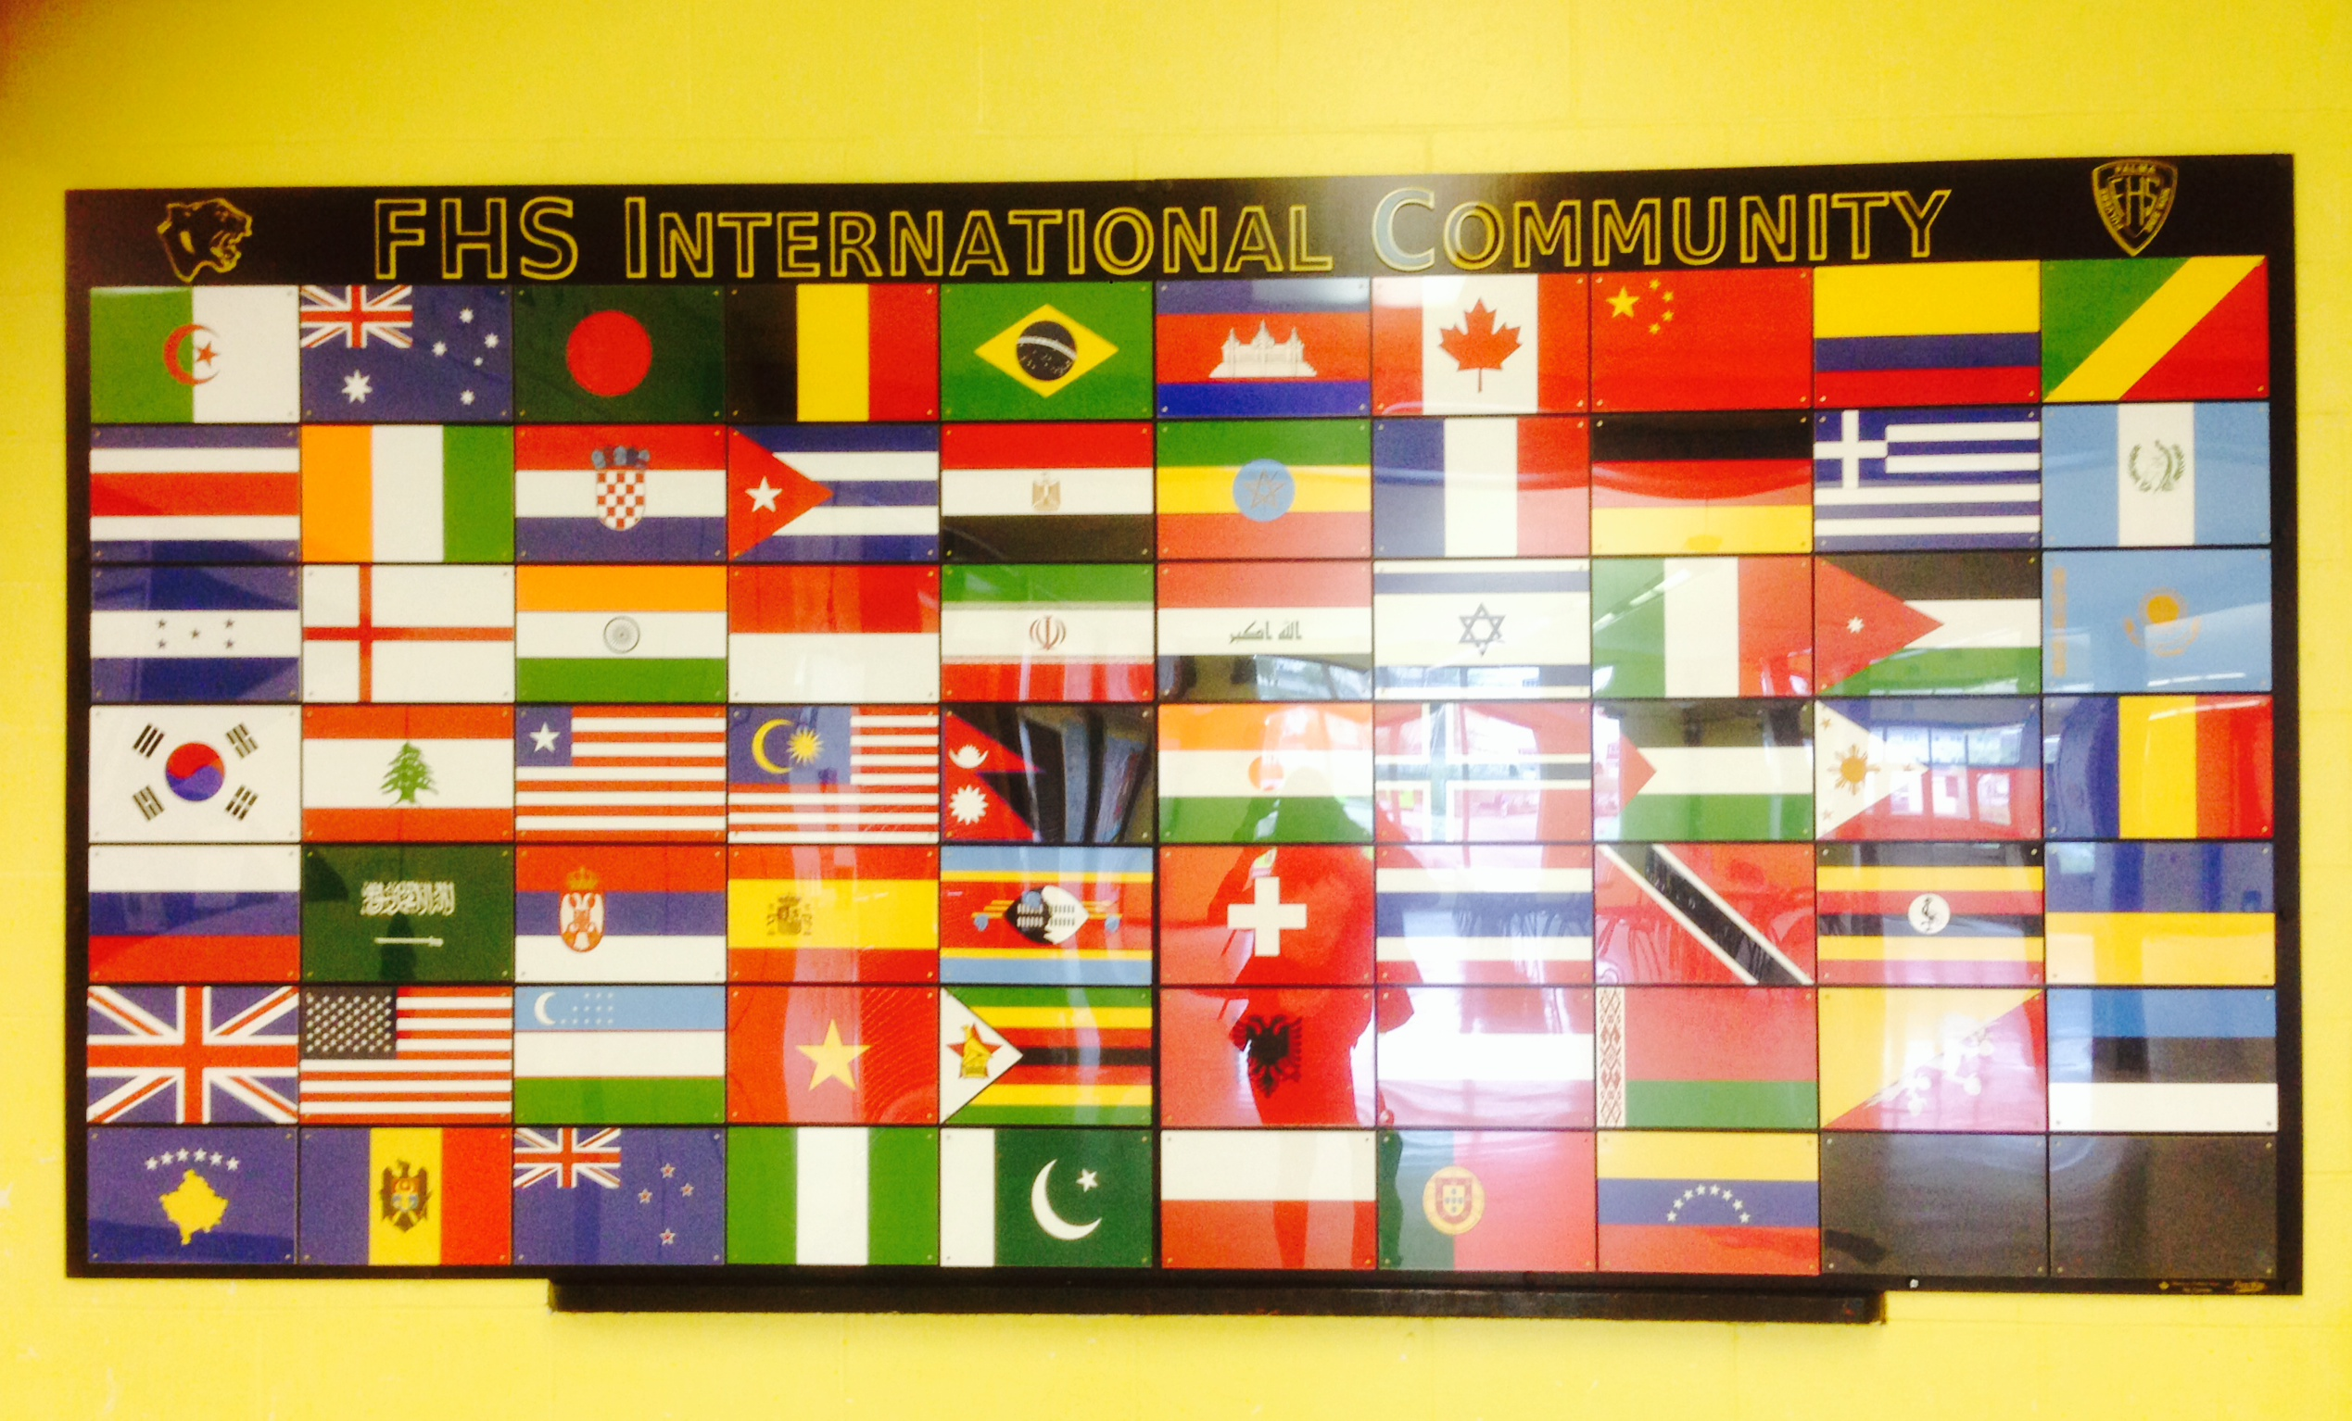
International Students
A rich multicultural community
Black Kat Ambassadors Club

Slide 11
TIPS FOR PARENTS
Attendance
There is a direct link between school attendance and academic performance.
You will receive an automated phone message and email indicating student absences when your child is absent without parent consent. Please contact the school if you do not receive these notices.

Slide 12
TIPS FOR PARENTS
Homework – High school students do have homework!!
Many teachers keep information on TEAMS with homework requirements.
When in doubt, contact the teacher through email (all emails are on the FHS website)

Slide 13
TIPS FOR PARENTS
Parent-School Communication
It is important for you to stay in contact with the school.
If you have concerns, contact teachers, admin, guidance.
Keep an eye on the school website for announcements and upcoming events☺

Slide 14
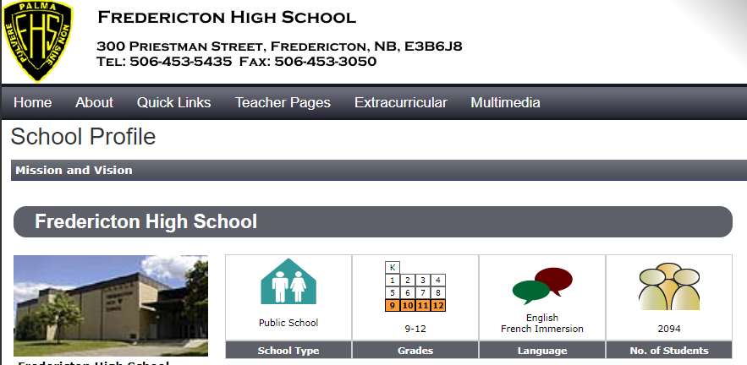
A Wealth of Knowledge at your Fingertips
Fredericton High School Website

Slide 15
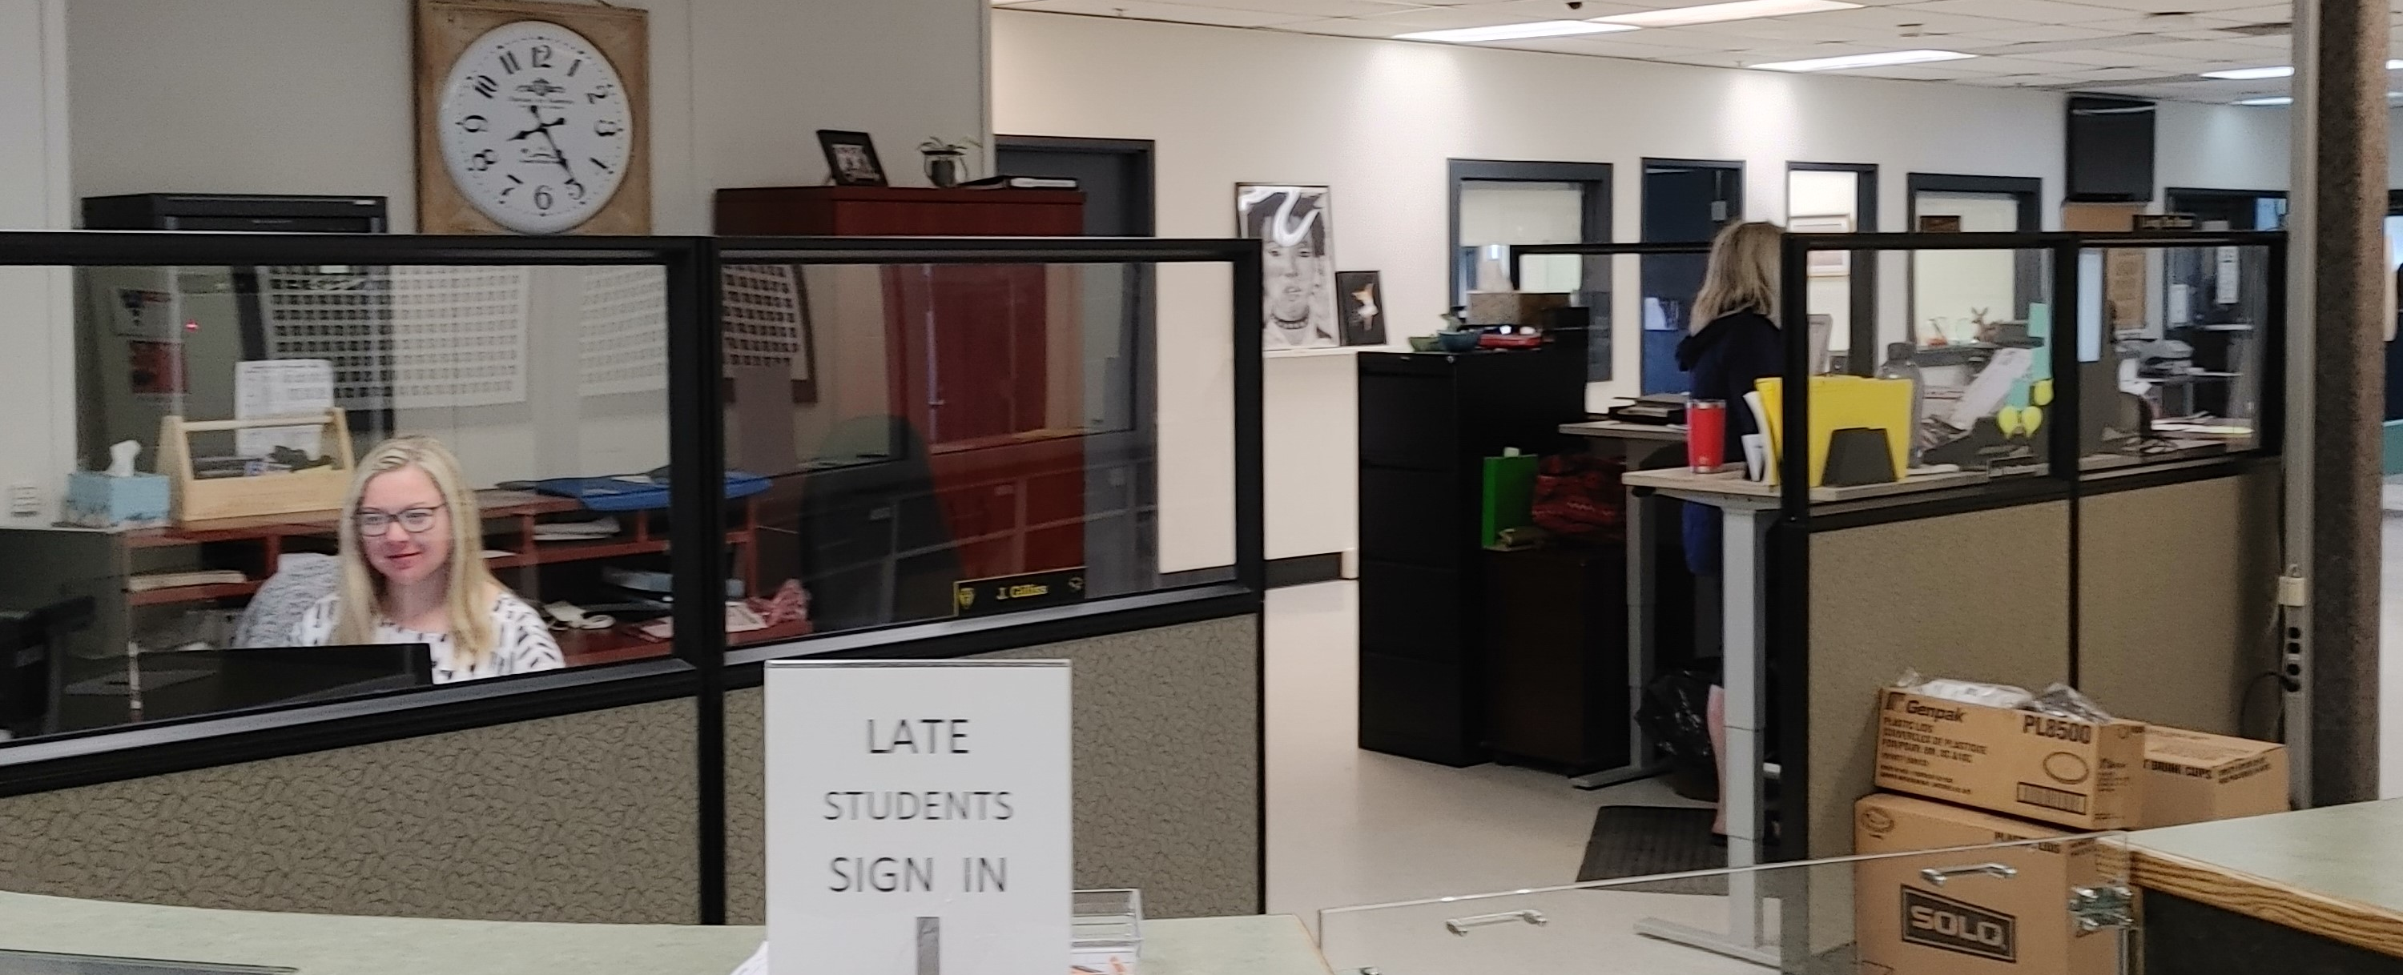
LATE ARRIVAL or leaving/returning for appointments
All doors lock at 8:30am
The only way to get in after 8:30am is the Main Office doors (get buzzed in). The main office doors are located off the Priestman Street entrance.
Students must sign in or out at the Main Office.

Slide 16
HOW TO BE SUCCESSFUL IN HIGH SCHOOL?
Develop good study habits
Get organized and stay organized
Go in for extra help as soon as you realize you truly do not understand a concept
Get involved to stay connected

Slide 17
First Day of School
Grade 9 Students – Tuesday, September 6th
Assemble in TMT
Meet Homeroom Teachers (schedules and lockers)
Meet Semester One teachers
Receive class information (course outlines, fees, required supplies)
Orientation and fun welcome activities throughout the day
See FHS website for more dates, contact info, etc..

Slide 18
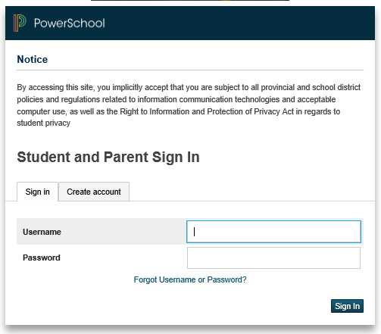
PowerSchool Public Portal
https://sisasdwtest.nbed.nb.ca/public/home.html

Slide 19
Parent Access Portal Single Sign-on
Parents can now become more involved partners in Education.
Attendance
Student Schedules
Assignments
School bulletins
Assignment criteria
Grades & Assessments
Teacher comments

Slide 20
Parent Access Portal Single Sign-on
You will receive the following information:
Public portal’s internet address
Instructions on how to create your account
In Sept: Your child’s Student Access ID & Password

Slide 21
Thank you for supporting your child by staying in the know
Guidance and Administration will remain at the front if you have any questions.
Tour will begin in 2 mins (leaving from the cafeteria)
This Photo by Unknown Author is licensed under CC BY-NC

